Slide 1

Unveiling the secrets of ML models for developing trustworthy tools
Created by :
DEVYANSH TIWARI(21-CS-14)
PRASHANT SEMWAL(21-CS-26)
RAMAN PANDEY(21-CS-31)
SUBMITTED TO: DR PREETI MISHRA

Slide 2
Contents
Introduction to Trustworthy ML Models
Downloading Network Binaries
Installing Cuckoo Sandbox
Using CIC Flow Meter for Feature Extraction
Data Preprocessing
Explainability Techniques
Model Training & Testing
Testing Process
Accuracy and Precision Of Each Model
Counterfactual Generation
Pre-Processing Counterfactual Data
Creating a New Dataset of Counterfactuals
Training and Testing Split
Conclusion

Slide 3
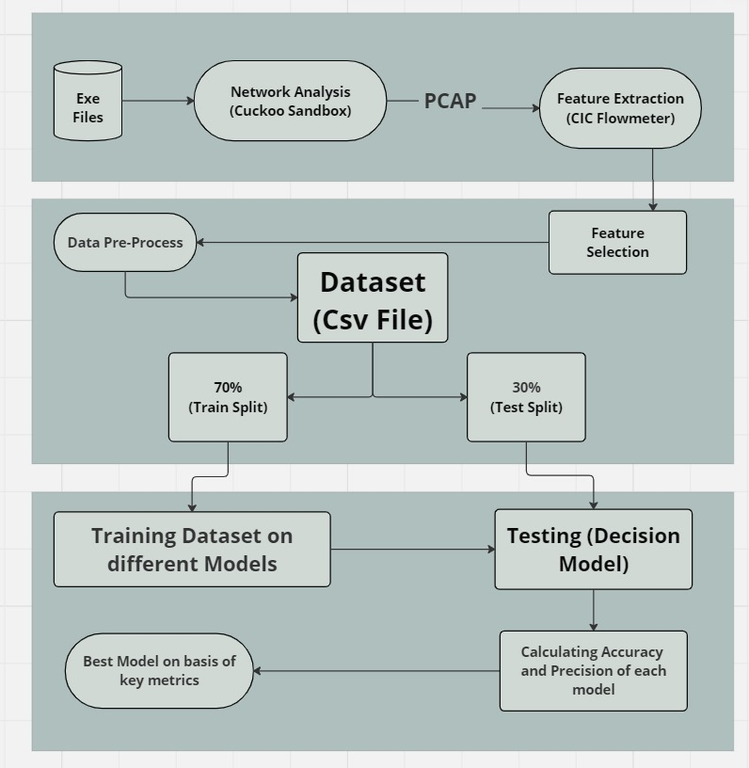
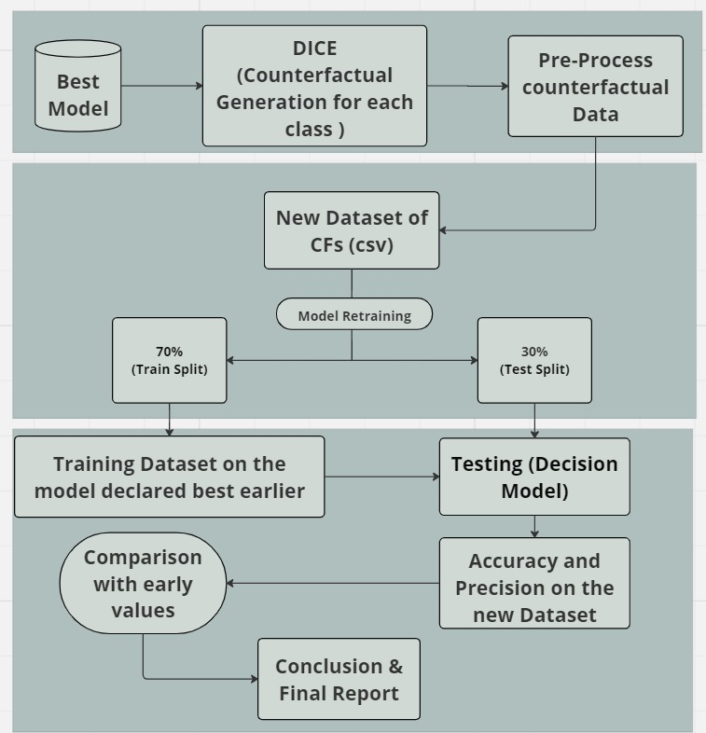

Slide 4
Introduction to Trustworthy ML Models
In today's data-centric world, ensuring the trustworthiness of machine learning (ML) models is crucial for their widespread adoption and effective deployment. Trustworthy ML models are those that are reliable, transparent, fair, and robust. These attributes help build user confidence and ensure that the models perform as intended without unintended biases or vulnerabilities.
Key Attributes of Trustworthy ML Models:
• Fairness •Accountability •Transparency •Robustness
By focusing on these key attributes, developers can create ML models that are not only effective but also ethically sound and legally compliant, fostering greater user trust and confidence in their applications.
1) https://research.ibm.com/topics/fairness-accountability-transparency

Slide 5
Introduction
Threats to Trustworthiness: Network Attacks
As machine learning models become more integral to various applications, their susceptibility to network attacks poses significant risks. These attacks can undermine the reliability, integrity, and trustworthiness of ML systems. Understanding these threats is crucial for developing robust defenses. There are two main types of attacks:
Active : Active attacks involve the attacker actively altering the data or the model's environment to achieve a specific malicious outcome.
Passive: Passive attacks involve the attacker monitoring or extracting information from the system without altering its state or data.

Slide 6
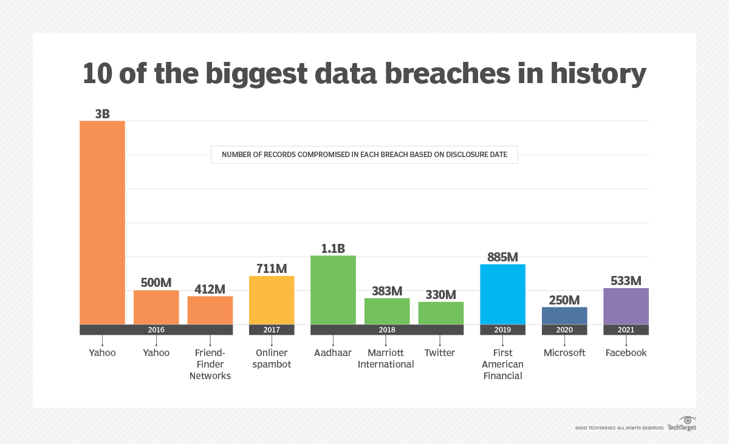
Figure 1.1 Network attacks report
https://usa.kaspersky.com/blog/biggest-ransomware-attacks-2023

Slide 7
Downloading Network Binaries
• Network Binaries
Network binaries are executable files that are used in network communication.
They include software, firmware, and other executable codes that can be analyzed for security purposes.
• Sources
Network binaries can be obtained from official software repositories, firmware updates, or collected from network traffic.
Ensure binaries are from reputable sources to avoid tampered or malicious files.
• Tools and Methods :
Use hash checks (e.g., SHA256) to verify the integrity of the binaries.
Employ download managers to ensure successful and complete downloads.

Slide 8

Cuckoo Sandbox
Figure 1.2 Cuckoo Sandbox
Cuckoo Sandbox is a widely-used open-source automated malware analysis system. It allows for the execution of files and analysis of their behavior in an isolated environment.

Slide 9
Installing Cuckoo Sandbox
Install Required Dependencies:
Python and development tools
Database systems like MongoDB and PostgreSQL
Networking tools and virtualization software
Installing Cuckoo Sandbox:
Download the latest version of Cuckoo from its official GitHub repository.
Use pip to install all necessary Python packages listed in the requirements file.
Customize cuckoo.conf and other configuration files to match your environment setup.
Create and configure the PostgreSQL database for Cuckoo.
Setup Virtual Machine:
Install a Windows virtual machine using VirtualBox or QEMU.
Configure the VM with the Cuckoo agent for interaction with the sandbox.
https://github.com/cuckoosandbox/cuckoo

Slide 10
Running Cuckoo Sandbox
After installation, running Cuckoo Sandbox involves a few key steps to analyze malware and generate detailed reports.
Starting Cuckoo Sandbox:
Initialize Services: Ensure all necessary services are running. This includes Cuckoo itself and any related database and networking services.
Submit Samples: Use the command line or web interface to submit files or URLs for analysis.
Monitor Progress: Track the analysis process through logs or the web interface to ensure proper execution.
Web Interface Usage:
Accessing the Interface: Open a browser and navigate to http://localhost:8000.
Job Submission: Easily submit new files or URLs for analysis.
Report Viewing: Access detailed analysis reports including behavioral data, network activity, and system changes.
Analysis and Reports:
Detailed Insights: Cuckoo provides comprehensive reports covering various aspects of the analyzed sample.
Export Options: Reports can be exported in multiple formats for further analysis or sharing.
https://cuckoosandbox.org/documentation/https://cuckoosandbox.org/documentation/

Slide 11
Using CIC Flow Meter for Feature Extraction
CIC Flow Meter is a tool for generating and analyzing network traffic flows, extracting valuable features from .pcap files. This is essential for network traffic analysis and machine learning applications.
Steps to Use CIC Flow Meter :
Download and Setup: Obtain from GitHub(1) and follow installation instructions.
Import .pcap files generated by Cuckoo Sandbox for feature extraction.
Feature Extraction:
Process: Run CIC Flow Meter to extract features.
Output: Generates a CSV file with features such as Flow Duration, Total Packets, Bytes per Second, and Packet Length Statistics.
Benefits:
Comprehensive Features: Provides detailed network flow features.
User-Friendly: Easy to install and use.
Integration: Compatible with machine learning tools.
(1) https://github.com/ahlashkari/CICFlowMeter
https://github.com/datthinh1801/cicflowmeter

Slide 12
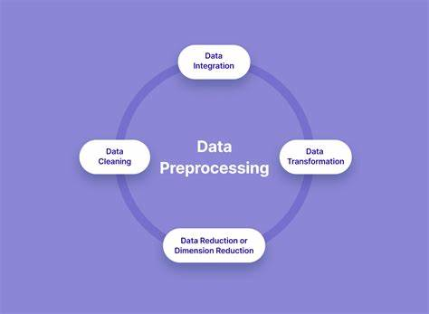
Data Preprocessing
• Importance :
Preprocessing prepares raw data for analysis by cleaning and transforming it.
Ensures the data is in a suitable format for machine learning models.
• Steps Involved :
Data Cleaning: Remove or correct errors and inconsistencies.
Normalization: Scale features to a standard range to ensure fair comparisons.
Handling Missing Values: Impute missing data or remove incomplete records.
Figure 1.3 data preprocessing

Slide 13
Explainability Techniques
Explainability refers to the extent to which the internal mechanics of a machine learning model can be explained in human terms.
Techniques :
• LIME (Local Interpretable Model-agnostic Explanations):
Provides local explanations for individual predictions.
• SHAP (SHapley Additive exPlanations) :
Offers global and local interpretability by assigning an importance value to each feature.
Importance :
Enhances transparency and trust in the model.
Helps in debugging and improving the model by understanding its decisions.

Slide 14
Model Training & Testing
Split the dataset into training and testing sets (80 percent and 20 percent).
Use the training set to teach the model to recognize patterns in the data.
The following algorithms we used to train the model :
• K-Nearest Neighbors (KNN)
• Neural Network
• Nearest Centroid
• Gradient Boosting Machine (GBM)
• Deep Neural Network (DNN)
Tools :
Scikit-learn: Used for implementing KNN, nearest centroid, and GBM algorithms.(1)
TensorFlow / Keras: Used for implementing neural networks and deep learning models.(2)
1) https://www.tensorflow.org/
2) https://scikit-learn.org/

Slide 15
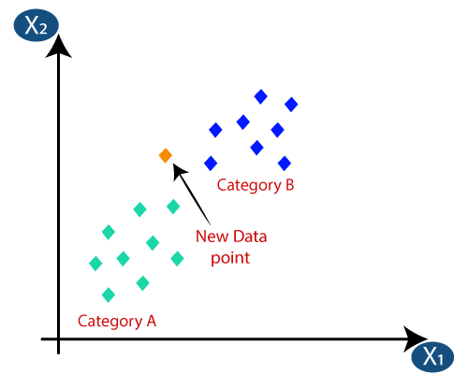
K-Nearest Neighbors (KNN)
The K-Nearest Neighbors (KNN) algorithm is a supervised learning method used for classification and regression. It classifies a data point based on how its neighbors are classified. The algorithm identifies the 'k' closest training examples in the feature space and predicts the label based on the majority label (for classification) or the average (for regression) of these neighbors.
https://morioh.com/p/347a9262da98

Slide 16
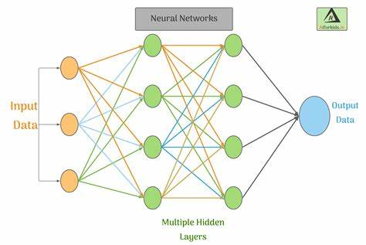
Neural Network
A neural network is a computational model inspired by the human brain. It consists of layers of interconnected nodes (neurons) that process input data to recognize patterns and make predictions. Neural networks learn by adjusting the weights of these connections based on the input and output data.
Applications:
Image and speech recognition
Natural language processing
Autonomous vehicles
Financial forecasting

Slide 17
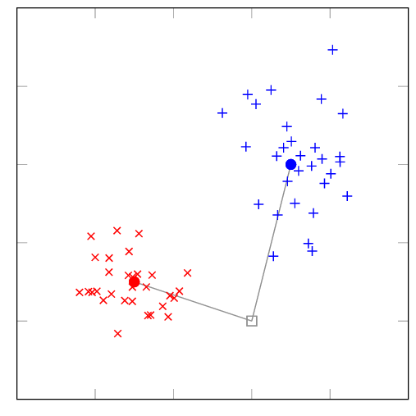
Nearest Centroid
The nearest centroid algorithm, also known as the nearest mean algorithm or the nearest prototype algorithm, is a simple and intuitive classification algorithm used in machine learning. It operates by assigning a new data point to the class whose centroid (mean) is closest to the data point in terms of Euclidean distance.
https://scikit-learn.org/stable/modules/generated/sklearn.neighbors.NearestCentroid.html

Slide 18
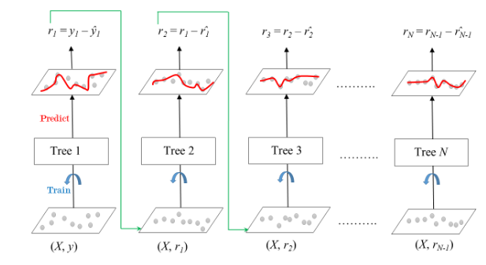
Gradient Boosting Machine (GBM)
Gradient boosting is a machine learning technique that builds an ensemble of weak learners, usually decision trees, in a sequential manner. It works by iteratively training new models to correct the errors of the previous models. Each new model focuses on the residuals (the differences between predicted and true values) of the ensemble, optimizing a loss function through gradient descent. The final prediction is made by combining the predictions of all the weak learners in the ensemble. This approach often leads to highly accurate predictive models, making gradient boosting popular for regression and classification tasks in various domains.
https://scikit-learn.org/stable/modules/ensemble.html#gradient-boosting

Slide 19
Testing Process
Evaluate the model’s performance using a separate testing set that was not used during training.
Ensure that the model generalizes well to unseen data, avoiding overfitting.
• Metrics Used for Evaluation :
Accuracy: Proportion of correct predictions over total predictions.
Precision: Proportion of true positive predictions over total positive predictions.
Recall: Proportion of true positive predictions over total actual positives.
F1-Score: Harmonic mean of precision and recall, providing a balance between them.
• Tools :
Scikit-learn: Used for implementing KNN, nearest centroid, and GBM algorithms.
TensorFlow / Keras: Used for implementing neural networks, deep neural networks, and deep learning models.

Slide 20
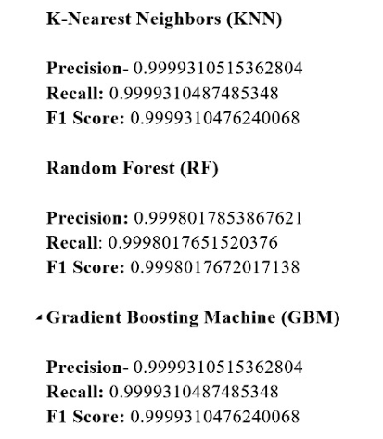
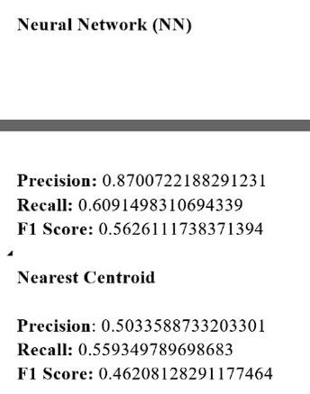
Accuracy and Precision Of Each Model
GBM has the best accuracy so we will train our dataset on it.

Slide 21
Counterfactual Generation
Counterfactuals are alternative scenarios created by changing certain input features to see how those changes would affect the model's prediction.
Purpose of Counterfactual:
To understand and interpret the model's decision-making process.
To identify how changing input features can alter the output class.
DICE:
DICE stands for Diverse Counterfactual Explanations.
It generates diverse and plausible counterfactual examples to explain model predictions.
We Used the best model (GBM) to generate counterfactuals for each class.
Ensuring diversity and feasibility of generated counterfactuals.

Slide 22
Pre-Processing Counterfactual Data
Steps Involved:
Cleaning: Remove any inconsistencies or errors in the counterfactual data.
Normalization: Ensure all data is on a similar scale to improve model performance.
Feature Engineering: Create or modify features to better capture patterns in the data.
Balancing Classes: Ensure that each class is adequately represented to prevent model bias.
Tools and Techniques:
Use Python libraries such as Pandas for data manipulation.
Apply scaling methods like Min-Max Scaler or Standard Scaler from scikit-learn.
Techniques like SMOTE (Synthetic Minority Over-sampling Technique) for balancing classes.

Slide 23
Creating a New Dataset of Counterfactuals
Process Overview:
Generate Counterfactuals: Use DICE to generate diverse and feasible counterfactuals.
Aggregate Data: Combine the original data with the new counterfactual examples.
Save as CSV: Store the combined dataset in a CSV file for easy access and processing.
Steps in Detail:
Counterfactual Generation: Generate multiple counterfactuals for each data point.
Data Integration: Merge the counterfactuals with the original dataset, ensuring each counterfactual is labeled appropriately.
CSV Creation: Export the integrated dataset into a CSV file, preserving data integrity and format.
Benefits:
Provides a richer dataset for model training.
Enhances model's understanding of decision boundaries.
Improves model's performance and generalizability.

Slide 24
Training and Testing Split
Purpose of Splitting the Dataset:
To evaluate the model's performance on unseen data and prevent overfitting.
Dataset Split Ratio:
Training Set: 70% of the new dataset
Testing Set: 30% of the new dataset
Steps in Splitting the Dataset
Shuffle Data: Randomly shuffle the dataset to ensure a good mix of examples.
Split Data: Divide the dataset into training and testing sets using a 70-30 ratio.
Ensure Class Balance: Make sure both sets have a balanced representation of all classes.
Importance of the Split
Training set is used to retrain the model with counterfactual data.
Testing set is used to evaluate the model's accuracy and precision on new data.

Slide 25
Conclusion
Summary of the Process:
Data Collection: Downloaded recent network binaries and generated logs using Cuckoo Sandbox.
Feature Extraction: Utilized CIC Flow Meter to extract features from .pcap files.
Data Pre-Processing: Handled missing values, performed type conversion, normalization, and standardization.
Explainable Techniques: Applied explainable methods during pre-processing, feature selection, and model results phases using DICE for counterfactual explanations.
Model Building: Implemented and compared various ML/DL algorithms to select the best performing model.
Key Findings:
Successful integration of counterfactual explanations to build user trust and confidence.
Improved model interpretability through explainable techniques in every phase.
Comparison of multiple ML/DL models based on TPR, TNR, FPR, FNR, and ROC curves to identify the best model.

Slide 26
Conclusion
Model Performance:
The selected model (GBM) demonstrated superior performance across all evaluated metrics.
Enhanced understanding of model decisions through counterfactual explanations, leading to better transparency.
Implications:
The approach provides a robust framework for building and evaluating machine learning models in cybersecurity.
Counterfactual explanations significantly contribute to trust and user confidence in model predictions.

Slide 27


